Slide 1

CSS part 2
Let’s know more about Cascading Style Sheets
Prepared by Helena Natanael, for FWD by dibimbing.id

Slide 2
1
Span and Div
2
Border Properties
3
Width and Height
Outline
4
Layout
5

Slide 3
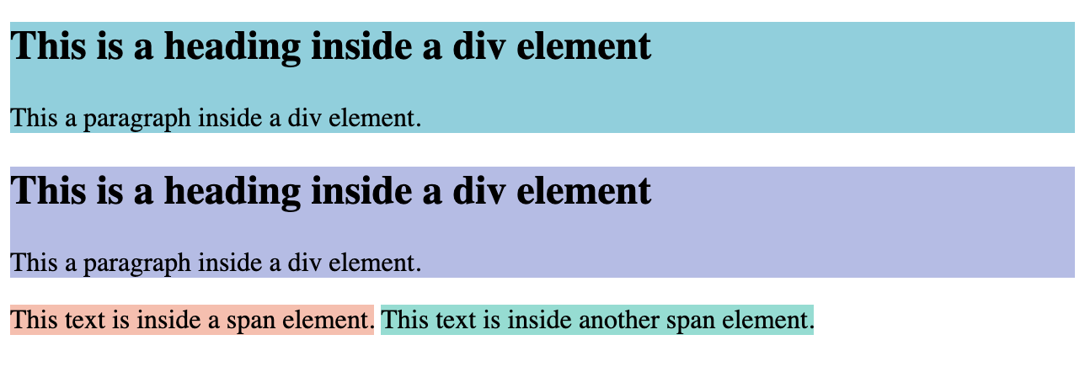
Span and Div
Span: used for inline styling
Div: used for block/container styling
1 of 11

Slide 4

Box Model of a HTML element
2 of 11

Slide 5
Border Properties
border-width
border-style
border-color
border-radius
Let’s jump into hands-on to understand more!
3 of 11

Slide 6
Width and Height
Width: defines the content width Height: defines the content height
Let’s jump into hands-on to understand more!
4 of 11

Slide 7
Layout
There are 3 ways to style the HTML layout:
Floats
Position
Display (Box Model, Flexbox, Grid)
5 of 11

Slide 8
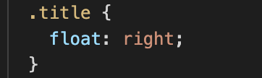
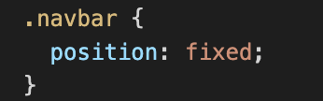
1 Float
Usually used in a paragraph. Values: none (default), left, right
2 Position
Used to specify behavior of an element . Values: static (default), fixed, sticky, relative, absolute.
6 of 11
Notes:
https://developer.mozilla.org/en-US/docs/Web/CSS/position

Slide 9
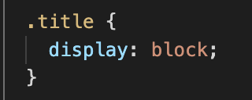
3 Display
Values: block (default), inline-block, inline, none, flex, grid
7 of 11

Slide 10
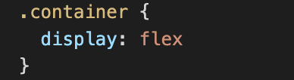
Detailed Explanation
Display: Flex
Most used in modern Web Apps. It makes the elements positioning flexible, no need to hassle with float and position for most cases.
Learn how to use flexbox: https://flexboxfroggy.com/
8 of 11

Slide 11
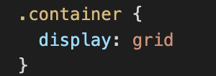
Detailed Explanation
Display: Grid
Used for pages that contains list of products. The structure is similar to table.
The concept is used in Bootstrap Framework.
Learn how to use grid: https://css-tricks.com/snippets/css/complete-guide-grid/ https://grid.layoutit.com/ https://learncssgrid.com/
9 of 11

Slide 12
Ice Breaking

Slide 13



Live Demo
Let’s try to recreate some logo using HTML and CSS! Link GitHub: https://github.com/helenant007/dibimbing-id
10 of 11

Slide 14
Assignment
Based on previous assignment, add CSS to beautify the single page HTML
Use all CSS properties that we have learned in the project. You’ll get a perfect score if you add more CSS properties that you find outside the bootcamp. Please use div or span instead of tables. Submit H+7 in LMS
11 of 11

Slide 15
Thank you
That’s all for this session!
References:
https://blog.hubspot.com/website/span-vs-div
https://css-tricks.com/almanac/properties/b/border
https://developer.mozilla.org/en-US/docs/Web/CSS/position
https://www.w3schools.com/cssref/pr_class_position.asp
https://www.w3schools.com/css/css_boxmodel.asp
https://stackoverflow.com/questions/3468154/what-is-webkit-and-how-is-it-related-to-css
https://rifatnajmi.com/design/px-em-rem/
Prepared by Helena Natanael, for FWD by dibimbing.id

